Slide 1
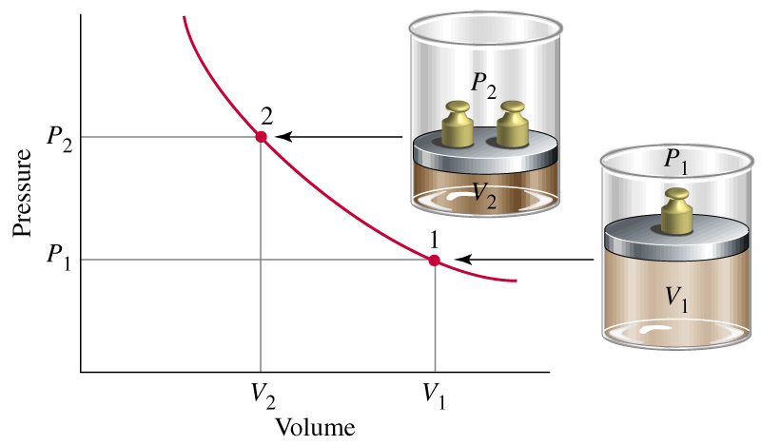
Chapter 6: Gases
General Chemistry
Principles and Modern Applications
Petrucci • Harwood • Herring
8th Edition
Philip Dutton
University of Windsor, Canada
Prentice-Hall © 2002
Notes:
Iron rusts
Natural gas burns
Represent chemical reactions by chemical equations.
Relationship between reactants and products is STOICHIOMETRY
Many reactions occur in solution-concentration uses the mole concept to describe solutions

Slide 2
Contents
6-1 Properties of Gases: Gas Pressure
6-2 The Simple Gas Laws
6-3 Combining the Gas Laws:
The Ideal Gas Equation and
The General Gas Equation
6-4 Applications of the Ideal Gas Equation
6-5 Gases in Chemical Reactions
6-6 Mixtures of Gases

Slide 3
Contents
6-6 Mixtures of Gases
6-7 Kinetic—Molecular Theory of Gases
6-8 Gas Properties Relating to the
Kinetic—Molecular Theory
6-9 Non-ideal (real) Gases
Focus on The Chemistry of Air-Bag Systems

Slide 4
6-1 Properties of Gases: Gas Pressure
Gas Pressure
Liquid Pressure
Force (N)
P (Pa) =
Area (m²)
P = g ·h ·d
Notes:
Difficult to measure force exerted by gas molecules
Measure gas pressure indirectly by comparing it with a liquid pressure.
Liquid pressure depends only on the height of the liquid column and the density of the liquid.

Slide 5
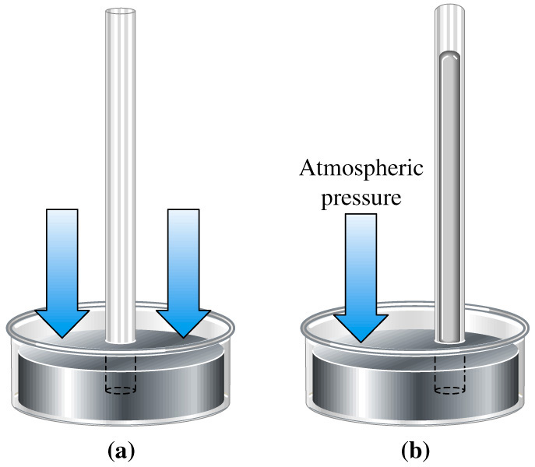
Barometric Pressure
Standard Atmospheric Pressure
1.00 atm
760 mm Hg, 760 torr
101.325 kPa
1.01325 bar
1013.25 mbar
Notes:
1 atm = 760 mm Hg when
δHg = 13.5951 g/cm3 (0°C)
g = 9.80665 m/s2
Mention here that P_{bar} refers to MEASURED ATMOSPHERIC PRESSURE in the text.

Slide 6
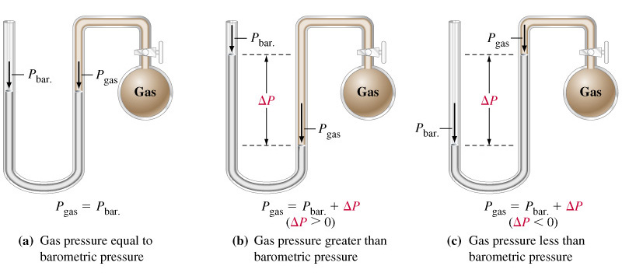
Manometers
Notes:
Difficult to place a barometer inside a gas to be measured.
Manometers compare gas pressure and barometric pressure.

Slide 7
6-2 Simple Gas Laws
1
Boyle 1662
PV = constant
P 
V

Slide 8
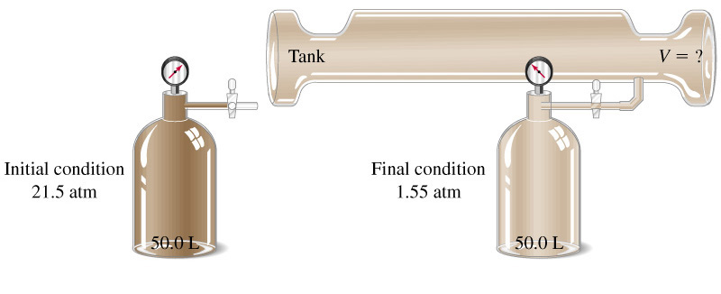
Example 5-6
Relating Gas Volume and Pressure – Boyle’s Law.
P₁V₁
P₁V₁ = P₂V₂
V₂ =
= 694 L
V_{tank} = 644 L
P₂

Slide 9
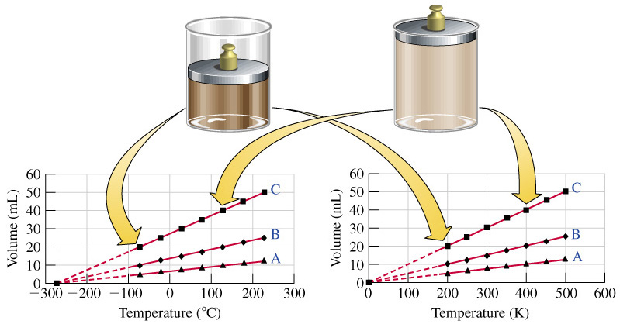
Charles’s Law
V  T
V = b T
Charles 1787
Gay-Lussac 1802
Notes:
Three different gases show this behavior with temperature.
Temperature at which the volume of a hypothetical gas becomes 0 is the absolute zero of temperature.
The hypothetical gas has mass, but no volume, and does not condense into a liquid or solid.

Slide 10
STP
Gas properties depend on conditions.
Define standard conditions of temperature and pressure (STP).
P = 1 atm = 760 mm Hg
T = 0°C = 273.15 K

Slide 11
Avogadro’s Law
Gay-Lussac 1808
  Small volumes of gases react in the ratio of small whole numbers.
Avogadro 1811
  Equal volumes of gases have equal numbers of molecules and
  Gas molecules may break up when they react.

Slide 12
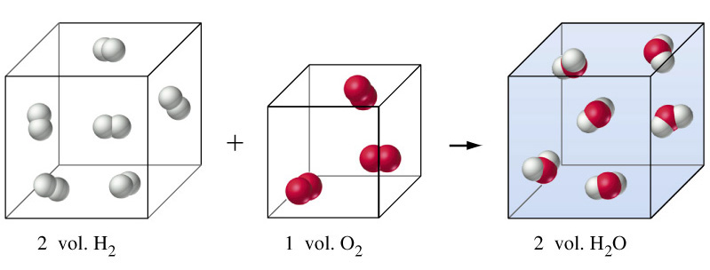
Formation of Water
Notes:
Dalton thought H + O → HO so ratio should have been 1:1:1. So the second part of Avogadro’s hypothesis is critical.
This identifies the relationship between stoichiometry and gas volume.

Slide 13
Avogadro’s Law
At an a fixed temperature and pressure:
V  n or V = c n
At STP
1 mol gas = 22.4 L gas

Slide 14
6-3 Combining the Gas Laws: The Ideal Gas Equation and the General Gas Equation
Boyle’s law V  1/P
Charles’s law V  T
Avogadro’s law V  n
nT
V 
P
PV = nRT
Notes:
Any gas whose behavior conforms to the ideal gas equation is called an ideal or perfect gas.
R is the gas constant. Substitute and calculate.

Slide 15
The Gas Constant
PV = nRT
PV
R =
nT
= 0.082057 L atm mol⁻¹ K⁻¹
= 8.3145 m³ Pa mol⁻¹ K⁻¹
= 8.3145 m³ Pa mol⁻¹ K⁻¹
= 8.3145 J mol⁻¹ K⁻¹

Slide 16
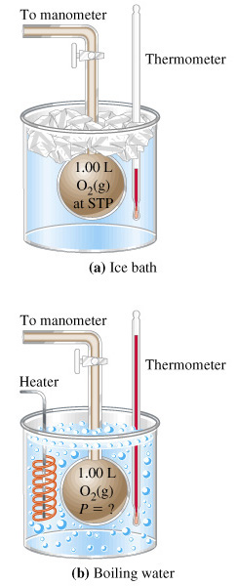
The General Gas Equation
P₁V₁
P₂V₂
R =
=
n₁T₁
n₂T₂
If we hold the amount and volume constant:
P₁
P₂
=
T₁
T₂

Slide 17
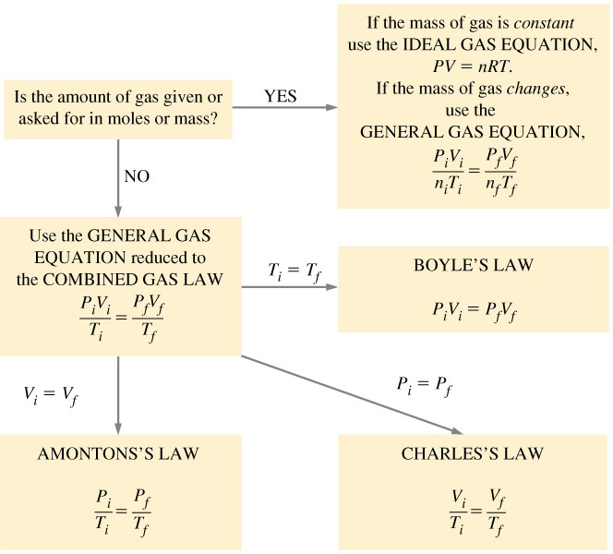
6-4 Applications of the Ideal Gas Equation

Slide 18
Molar Mass Determination
m
PV = nRT
and
n =
M
m
PV =
RT
M
m
RT
M =
PV

Slide 19
Example 6-10
Determining a Molar Mass with the Ideal Gas Equation.
Polypropylene is an important commercial chemical. It is used in the synthesis of other organic chemicals and in plastics production. A glass vessel weighs 40.1305 g when clean, dry and evacuated; it weighs 138.2410 when filled with water at 25°C (δ=0.9970 g cm⁻³) and 40.2959 g when filled with propylene gas at 740.3 mm Hg and 24.0°C. What is the molar mass of polypropylene?
Strategy:
Determine V_{flask}. Determine m_{gas}. Use the Gas Equation.

Slide 20
Example 5-6
Determine V_{flask}:
V_{flask} = m_{H2O}  d_{H2O} = (138.2410 g – 40.1305 g)  (0.9970 g cm⁻³)
= 98.41 cm³ = 0.09841 L
Determine m_{gas}:
m_{gas} = m_{filled} - m_{empty} = (40.2959 g – 40.1305 g)
= 0.1654 g

Slide 21
Example 5-6
Example 5-6
Use the Gas Equation:
m
m
RT
PV = nRT
PV =
RT
M =
M
PV
(0.6145 g)(0.08206 L atm mol⁻¹ K⁻¹)(297.2 K)
M =
(0.9741 atm)(0.09841 L)
M = 42.08 g/mol
Notes:
This gas must be ketene. There really are no other possibilities.

Slide 22
Gas Densities
m
m
PV = nRT
and
d =
, n =
V
M
m
PV =
RT
M
m
MP
= d =
V
RT

Slide 23
6-5 Gases in Chemical Reactions
Stoichiometric factors relate gas quantities to quantities of other reactants or products.
Ideal gas equation used to relate the amount of a gas to volume, temperature and pressure.
Law of combining volumes can be developed using the gas law.

Slide 24
Example 6-10
Using the Ideal gas Equation in Reaction Stoichiometry Calculations.
The decomposition of sodium azide, NaN₃, at high temperatures produces N₂(g). Together with the necessary devices to initiate the reaction and trap the sodium metal formed, this reaction is used in air-bag safety systems. What volume of N₂(g), measured at 735 mm Hg and 26°C, is produced when 70.0 g NaN₃ is decomposed.
2 NaN₃(s) → 2 Na(l) + 3 N₂(g)

Slide 25
Example 6-10
Determine moles of N₂:
1 mol NaN₃
3 mol N₂
= 1.62 mol N₂
n_{N2} = 70 g N₃ 

65.01 g N₃/mol N₃
2 mol NaN₃
Determine volume of N₂:
nRT
(1.62 mol)(0.08206 L atm mol⁻¹ K⁻¹)(299 K)
V =
=
P
1.00 atm
(735 mm Hg)
760 mm Hg
= 41.1 L

Slide 26
6-6 Mixtures of Gases
Gas laws apply to mixtures of gases.
Simplest approach is to use n_{total}, but....
Partial pressure
  Each component of a gas mixture exerts a pressure that it would exert if it were in the container alone.

Slide 27
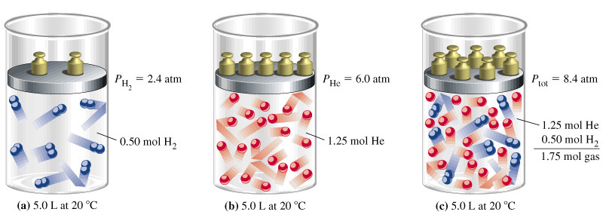
Dalton’s Law of Partial Pressure

Slide 28
Partial Pressure
P_{tot} = P_{a} + P_{b} +…
V_{a} = n_{a}RT/P_{tot} and V_{tot} = V_{a} + V_{b}+…
V_{a}
n_{a}RT/P_{tot}
n_{a}
=
=
V_{tot}
n_{tot}RT/P_{tot}
n_{tot}
n_{a}
Recall
=
χ_{a}
n_{tot}
P_{a}
n_{a}RT/V_{tot}
n_{a}
=
=
P_{tot}
n_{tot}RT/V_{tot}
n_{tot}
Notes:
Partial pressure is the pressure of a component of gas that contributes to the overall pressure.
Partial volume is the volume that a gas would occupy at the total pressure in the chamber.
Ratio of partial volume to total volume, or of partial pressure to total pressure is the MOLE FRACTION.

Slide 29
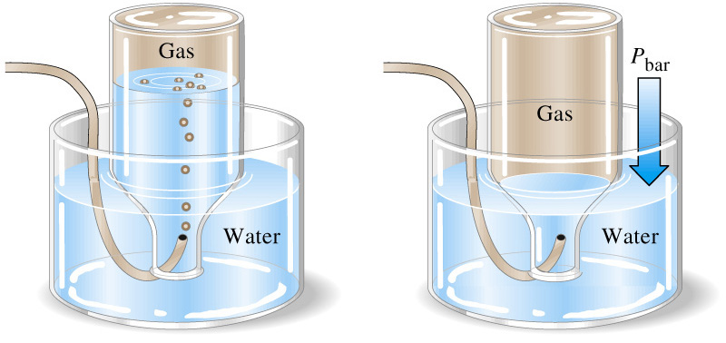
Pneumatic Trough
P_{tot} = P_{bar} = P_{gas} + P_{H2O}
Notes:
Total pressure of wet gas is equal to atmospheric pressure (P_{bar}) if the water level is the same inside and outside.
At specific temperatures you know the partial pressure of water.
Can calculate P_{gas} and use it stoichiometric calculations.

Slide 30

6-7 Kinetic Molecular Theory
Particles are point masses in constant, random, straight line motion.
Particles are separated by great distances.
Collisions are rapid and elastic.
No force between particles.
Total energy remains constant.
Notes:
Natural laws are explained by theories. Gas law led to development of kinetic-molecular theory of gases in the mid-nineteenth century.

Slide 31
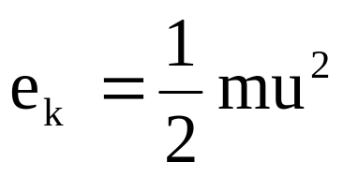
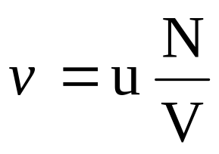

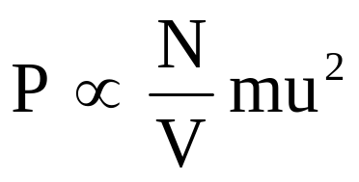
Pressure – Assessing Collision Forces
Translational kinetic energy,
Frequency of collisions,
Impulse or momentum transfer,
Pressure proportional to impulse times frequency

Slide 32
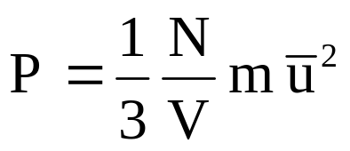
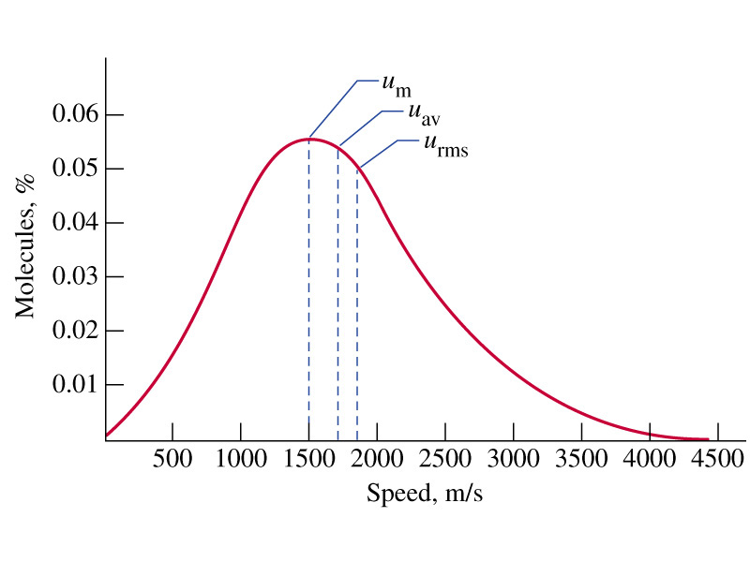

Pressure and Molecular Speed
Three dimensional systems lead to:
u_{m} is the modal speed
u_{av} is the simple average
u_{rms}

Slide 33
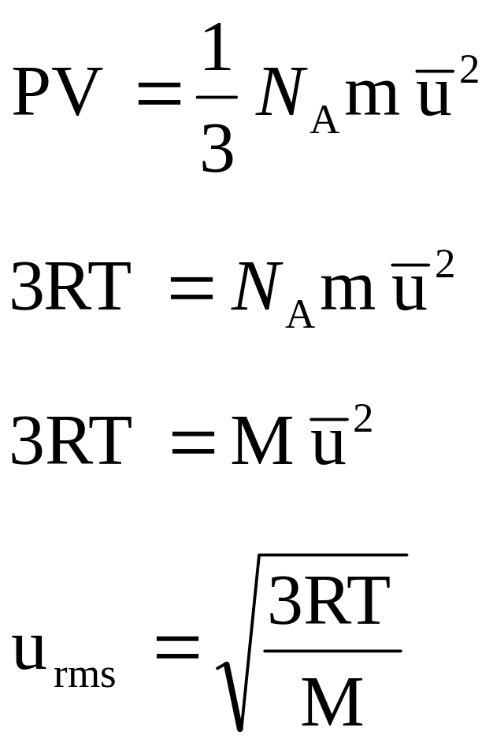
Pressure
Assume one mole:
PV=RT so:
N_{A}m = M:
Rearrange:

Slide 34
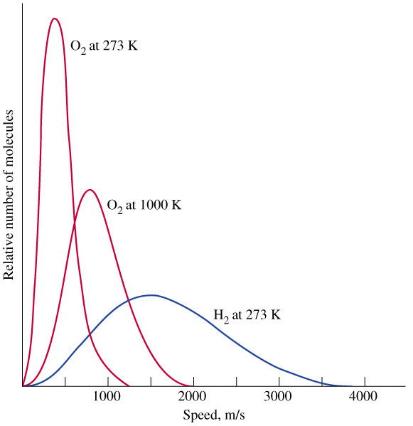
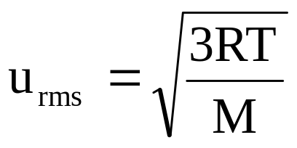
Distribution of Molecular Speeds
Notes:
Lighter gases have faster speeds.

Slide 35
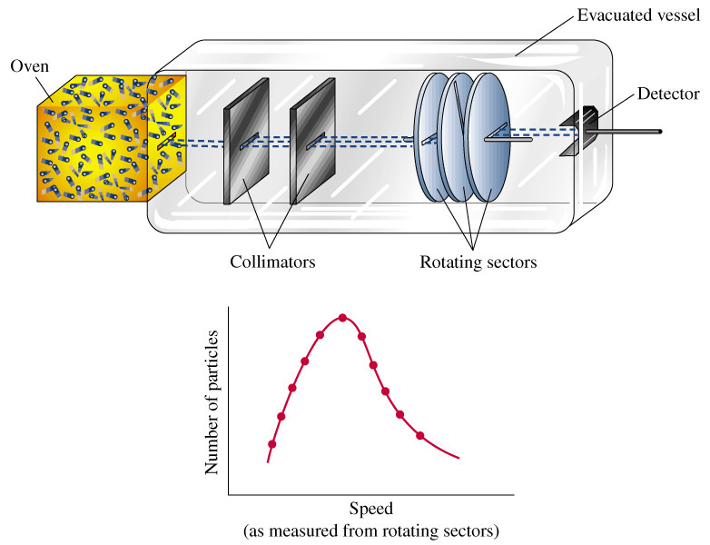
Determining Molecular Speed

Slide 36
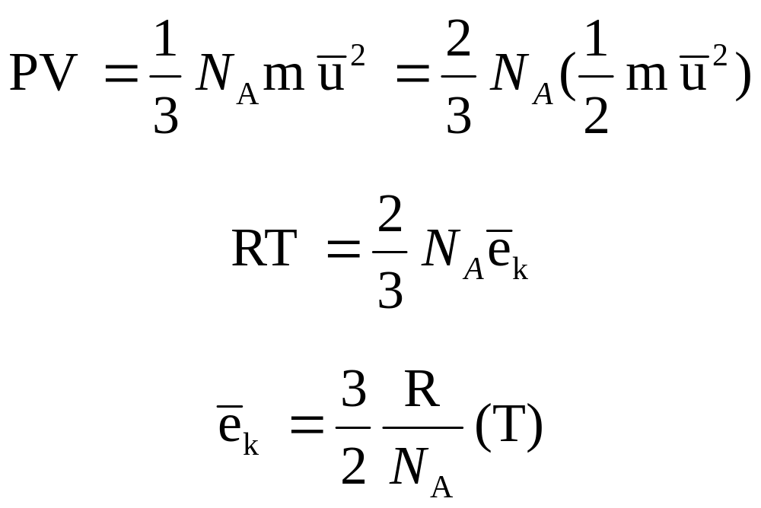
Temperature
Modify:
PV=RT so:
Solve for e_{k}:
Average kinetic energy is directly proportional to temperature!

Slide 37
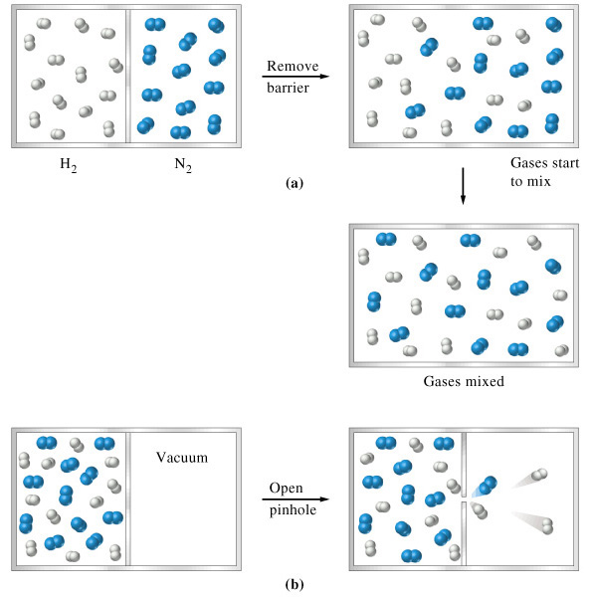
6-8 Gas Properties Relating to the
Kinetic-Molecular Theory
Diffusion
  Net rate is proportional to molecular speed.
Effusion
  A related phenomenon.

Slide 38
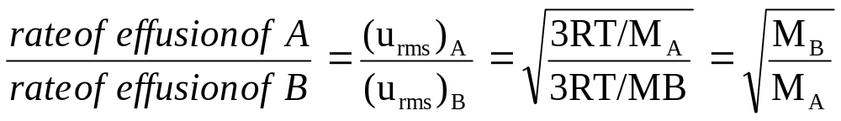
Graham’s Law
Only for gases at low pressure (natural escape, not a jet).
Tiny orifice (no collisions)
Does not apply to diffusion.
Ratio used can be:
  Rate of effusion (as above)
  Molecular speeds
  Effusion times
  Distances traveled by molecules
  Amounts of gas effused.

Slide 39
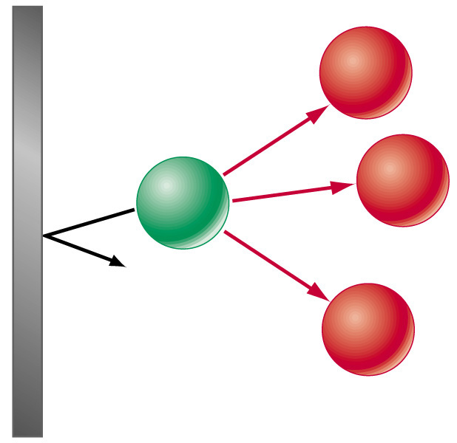
6-9 Real Gases
Compressibility factor PV/nRT = 1
Deviations occur for real gases.
  PV/nRT > 1 - molecular volume is significant.
  PV/nRT < 1 – intermolecular forces of attraction.

Slide 40
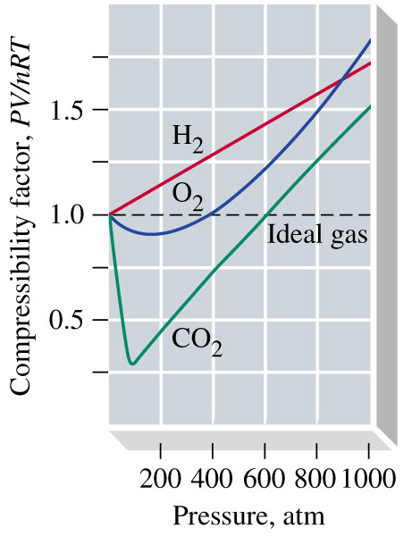
Real Gases

Slide 41
van der Waals Equation
n²a
P +
V – nb = nRT
V²

Slide 42
Chapter 6 Questions
9, 13, 18, 31, 45, 49, 61, 63, 71, 82, 85, 97, 104.

